Slide 1
Analog Scaling Instructions
Studio 5000
© 2014 John Sefcovic

Slide 2
SCALING
Scaling using program instructions:
Some Analog Modules provides scaling in the modules, there are modules which do not.
The data may be transferred over a network as raw binary data and will need to be scaled.
Scaling can be done in these languages with these instructions:
Ladder Logic: CPT (Compute) and ALMA (Alarm Analog) instructions.
Function Block: SCL (Scale) and ALM (Alarm) or CPT (Compute) instructions.
Structure Text: SCL (Scale) and ALM (Alarm) or CPT (Compute) instructions.

Slide 3
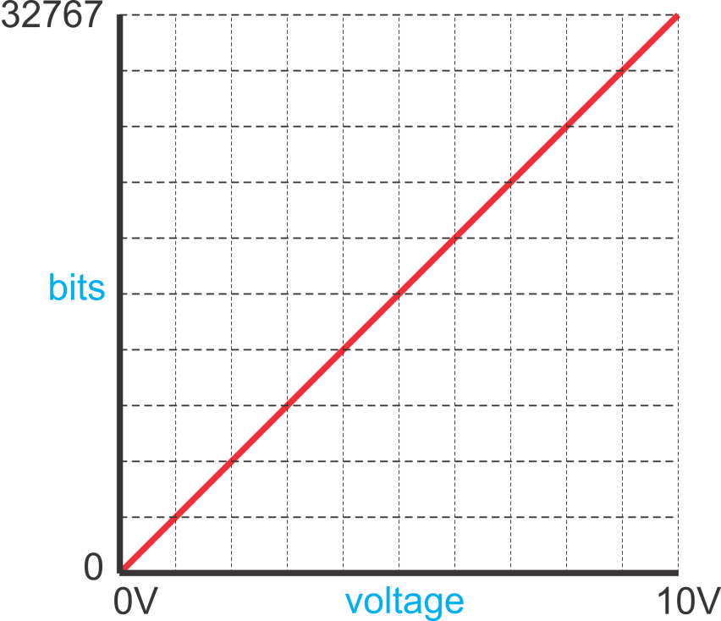
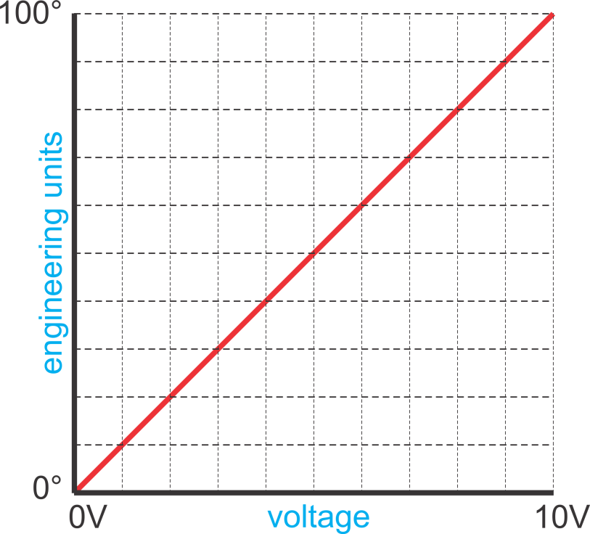
SCALING
For analog inputs and outputs, scaling is defining a ratio of the engineering units, the value range being measured, and the bit values produced by the electrical signal.

Slide 4
SCALING CALCULATIONS
bit min or max: minimum or maximum bit value of the module
scaled min or max: minimum or maximum value in engineering units, i.e. 0 psi. to 500 psi
scaled value: value in engineering units to determined from bit value
bit value: binary equivalent of scaled value
ANALOG INPUT (Bit value to Scaled Value)
Scaled value = (bit value x slope) + offset
Slope = (scaled max. – scaled min.) / (bit max. – bit min.)
Offset = scaled min. – (bit min. x slope)
ANALOG OUTPUT (Scaled value to Bit value)
Bit value = (scale value x slope) + offset
Slope = (bit max. – bit min.) / (scaled max. – scaled min.)
Offset = bit min. – (scaled min. x slope)

Slide 5
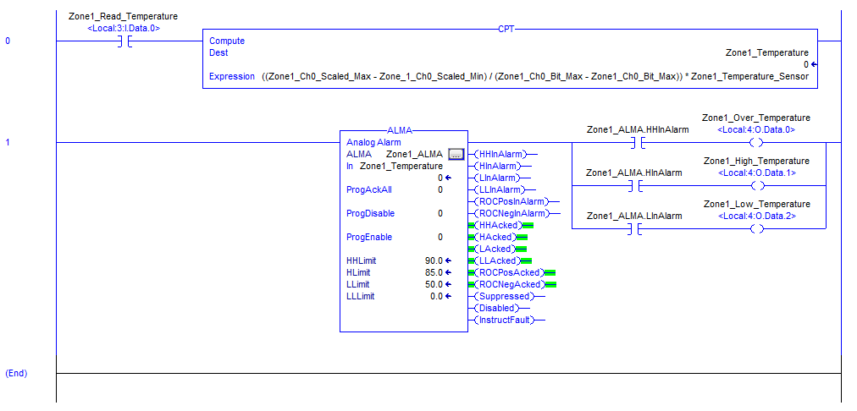
LADDER LOGIC SCALE

Slide 6

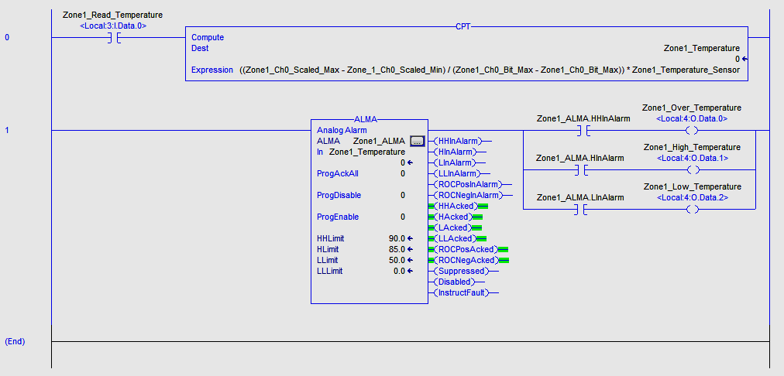
LADDER LOGIC SCALE
Input to Read/Scale the Analog Input.

Slide 7

LADDER LOGIC SCALE
The CPT instruction computes the scaling expression.
Scaled value = ((scaled max. – scaled min.) / (bit max. – bit min.)) x bit value
Slope = (scaled max. – scaled min.) / (bit max. – bit min.)
bit value: analog input
Scaled value: result in Engineering Units

Slide 8
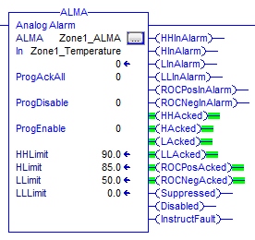
LADDER LOGIC SCALE
The ALMA (Alarm Analog) instruction defines the alarming set-points.

Slide 9
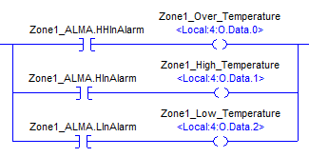
LADDER LOGIC SCALE
Outputs are set based on the Alarm status.

Slide 10
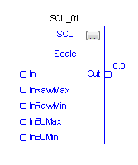
FUNCTION BLOCK SCALE
The SCALE (SCL) instruction converts an unscaled input value to a floating point value in engineering units.
In: Analog input in binary. 32767 to 0.
Out: Engineering units, scaled REAL value.
InRawMax: The maximum binary value attainable by the input.
InRawMin: The minimum binary value attainable by the input.
InEUMax: The maximum scaled value in Engineering Units.
InEUMin: The minimum scaled value in Engineering Units.

Slide 11
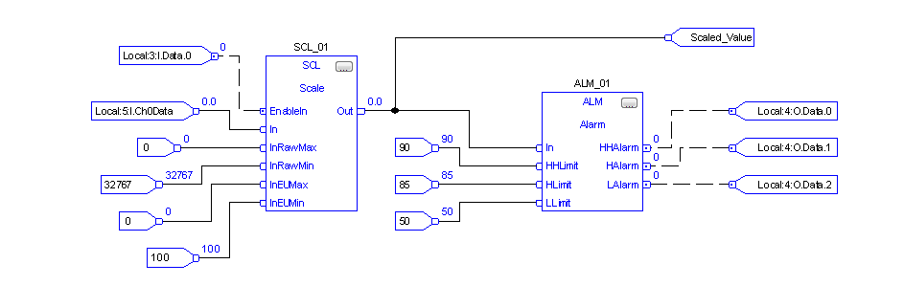
FUNCTION BLOCK SCALE
Example for an analog input:
Bits: 0 to 32767
Engineering Units: 0° to 100°
Input to Enable the scaling of the Analog Input. May be timed based or on event.

Slide 12

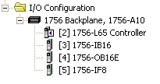
FUNCTION BLOCK SCALE
Example for an analog input:
Bits: 0 to 32767
Engineering Units: 0° to 100°
The Analog Input.
Module 5, an Analog Input and the first input, Channel 0.

Slide 13
FUNCTION BLOCK SCALE
Example for an analog input:
Bits: 0 to 32767
Engineering Units: 0° to 100°
The Maximum and Minimum Bit values.

Slide 14
FUNCTION BLOCK SCALE
Example for an analog input:
Bits: 0 to 32767
Engineering Units: 0° to 100°
The Maximum and Minimum Engineering Unit values.

Slide 15
FUNCTION BLOCK SCALE
Example for an analog input:
Bits: 0 to 32767
Engineering Units: 0° to 100°
The scaled Engineering Unit value from the Analog Input, the equivalent of the Bit Value.
Scaled value In to the Alarm.

Slide 16
FUNCTION BLOCK SCALE
Example for an analog input:
Bits: 0 to 32767
Engineering Units: 0° to 100°
The Alarm HighHigh, High, or Low setpoint limits.

Slide 17
FUNCTION BLOCK SCALE
Example for an analog input:
Bits: 0 to 32767
Engineering Units: 0° to 100°
The Alarm HighHigh, High, or Low outs assigned to a Module’s Outputs .

Slide 18
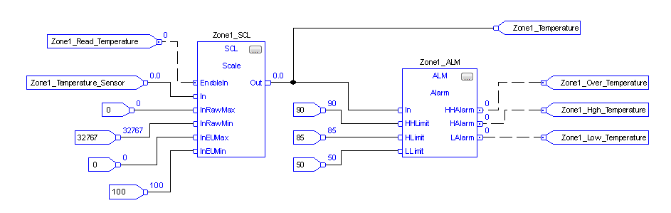
FUNCTION BLOCK SCALE
Example for an analog input:
Bits: 0 to 32767
Engineering Units: 0° to 100°
Physical module address’s replaced with Tags.

Slide 19
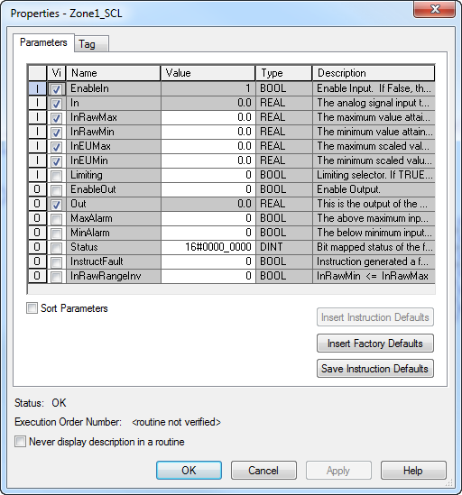
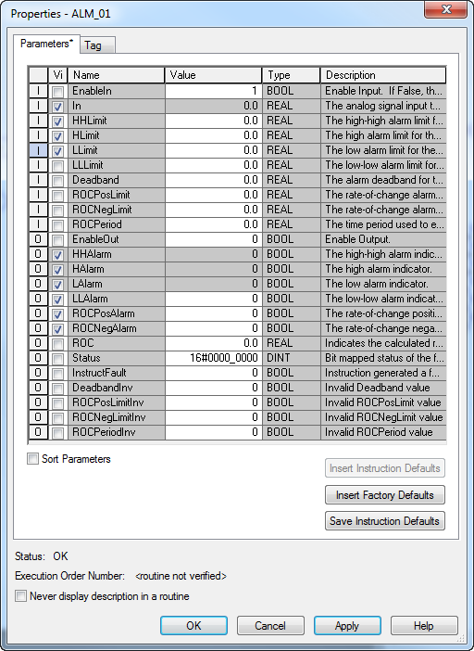
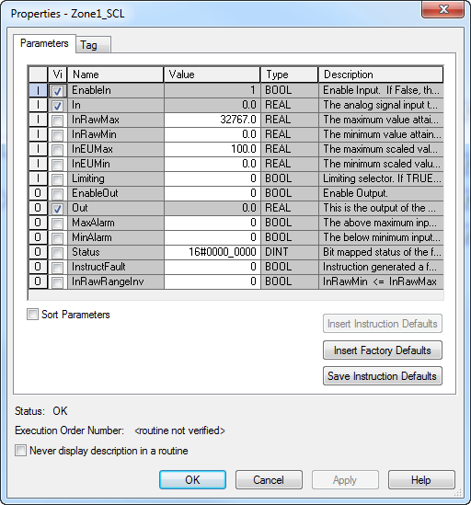


FUNCTION BLOCK SCALE
Example for an analog input:
Bits: 0 to 32767
Engineering Units: 0° to 100°
The ALARM parameters can be uncheck and the Constant values type in.
Uncheck the parameters and type in the Constant values.
The Constant values are entered.
The values are now assigned to the parameters
The logic can be simplified by added the constant values to the parameters.
Select the Parameters button.
The parameters are all constant values that will not change.

Slide 20
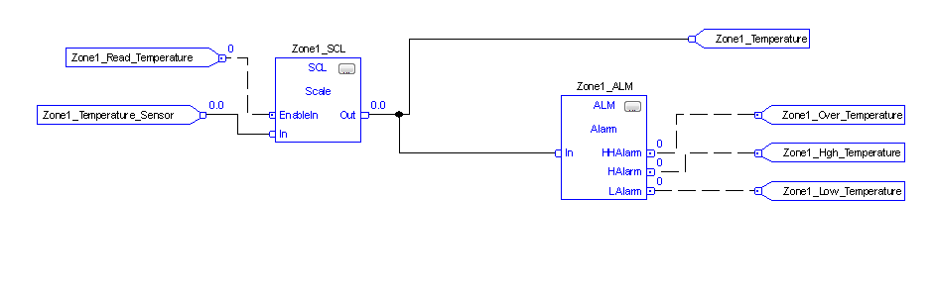
FUNCTION BLOCK SCALE
Example for an analog input:
Bits: 0 to 32767
Engineering Units: 0° to 100°
The logic is “simplified” by embedding the parameters into the instruction.

Slide 21
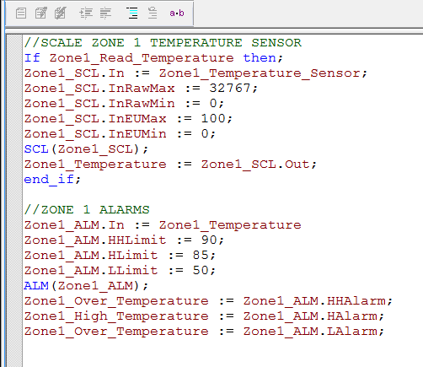
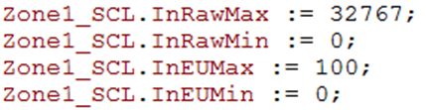




STRUCTURED TEXT SCALE
Example for an analog input:
Bits: 0 to 32767
Engineering Units: 0° to 100°
Digital Input to Read/Scale Analog Input.
Analog Input sensor to SCL instruction In.
Scaling Parameters.
SCL Out value to scaled temperature value Tag.
The SCALE instruction with the Tag Zone1_SCL.
Scaled temperature Tag to the ALM instruction In.
Alarm Parameters.
The ALARM instruction with the Tag Zone1_ALM.
Alarm Outs to Digital Outputs

Slide 22
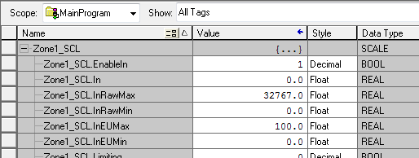
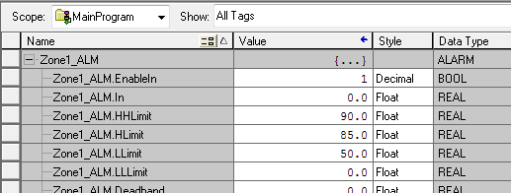
STRUCTURED TEXT SCALE
Example for an analog input:
Bits: 0 to 32767
Engineering Units: 0° to 100°
The logic can be simplified by entering the constants in the instruction’s Tag parameters.

Slide 23
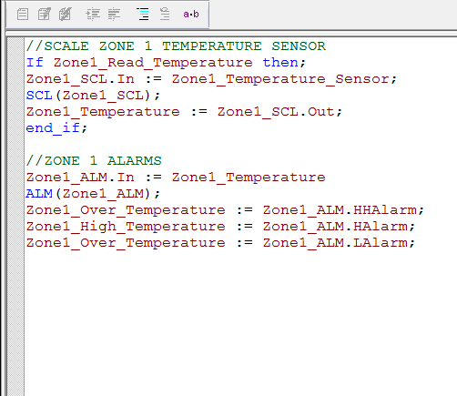
STRUCTURED TEXT SCALE
Example for an analog input:
Bits: 0 to 32767
Engineering Units: 0° to 100°
The logic is “simplified” by assigning the parameters to the instruction’s Tag.

